Slide 1
SNC Athletics Stress Survey & Database
Joseph Davy

Slide 2
Why?
Athletes have a lot on their plates which can lead to high stress
Create a more accessible & user-friendly survey

Slide 3
Project Objectives
Follow the provided Daily Check In example.
Research methods to send texts daily reminder texts.
Iterative development and meetings with SNC Athletics to clarify specifics
Method to automatically notify students that they need to fill out their daily check in.
Demonstrate helpful links for students who indicate they are dealing with high levels of stress.
Coaching staff needs a way to get reports about their players
Coaches would like to be able to set auto alert criteria
Weekly reports at minimum with readable presentation

Slide 4
Initial Task
Create a survey for SNC Athletics to assess the stress of their athletes.
Create a database to store those responses
Create a website for coaches to view the responses.

Slide 5
First Step: The Survey
Website Created with
HTML
Bootstrap
JavaScript
CSS
Data sent with
PHP
SQL
Setbacks:
Bootstrap
Buttons

Slide 6
Second Step: The Database
Created with:
The help of Dr. Diederich
MySQL Database
accessed through PHP files
Setbacks:
Remembering SQL
Combining SQL with PHP

Slide 7
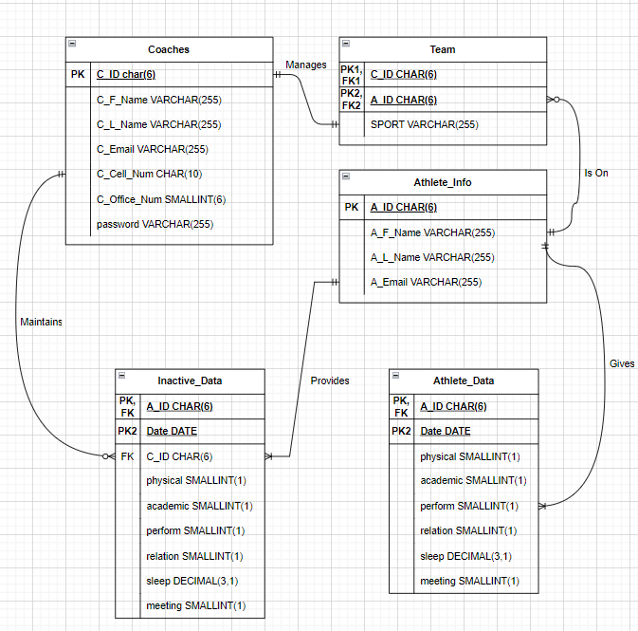
The Dreaded ERD
Setbacks:
Draw.io

Slide 8
Third Step: The Coach Website
Website created with
HTML
Bootstrap
JavaScript
CSS
Data retrieval
PHP
SQL
Setbacks:
SQL integration
Minor Visuals

Slide 9
Bootstrap
Templates
Resizing for mobile
Make things pretty

Slide 10
Exceptions
Auto-notifications
Email extensions
Weekly Reports
Daily check ins
Sending Athletes links

Slide 11
Demonstration
https://compsci04.snc.edu/cs460/2023/davyjr/project/athlete_survey.php
https://compsci04.snc.edu/cs460/2023/davyjr/project/coach_index.php

Slide 12
Learning Strategies
Lots of Google help
specifically W3Schools & the Bootstrap documentation
Meetings with Dr. Diederich & Dr. McVey
Old Class Labs and Notes
specifically from CSCI 330
ChatGPT
Mostly helped fix syntax

Slide 13
Extensions
Weekly report sent to coaches
Add more questions
very simple
Expand for the entire school
using counselors instead of coaches
Analysis of Stress
Engagement of Athletes
Getting accurate & good data from the athletes

Slide 14
Impact
Better Coach-Athlete bonds through open communication
Less stressed and better performing Athletes

Slide 15
Questions?

